Slide 1
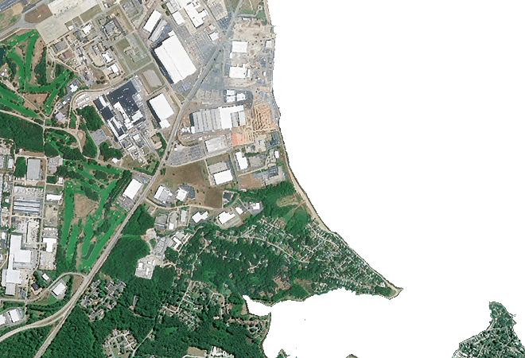


Cross-spectral DSMAC
Directorate of Artificial Intelligence & Visualisation,
Research Centre Imarat (RCI), Defence Research & Development Organisation (DRDO)
&
Defence Institute of Advanced Technology (DIAT)
Literature Survey
ON
Presented by:
Mohineet Kaur (25-26-08)
M. Tech (Artificial Intelligence)
Presented to:
A. Kalidasu (Scientist-E)

Slide 2
Table of Contents
Introduction
  DSMAC Navigation Framework
  DSMAC – General Working Pipeline
Literature Review
  Original DSMAC (1980)
  Advanced Scene Matching (1994)
  AI Based DSMAC
Evolution of DSMAC Image Matching
Current State-of-the-art Feature Matching Methods
Comparative Study of Existing Image Matching Methods
Limitations of Existing Approaches
Research Gap
Proposed Methodology
  Objective
  Proposed Framework
  Expected Advantages
References

Slide 3
Introduction
What is DSMAC?
DSMAC (Digital Scene Matching Area Correlation) is a vision-based navigation technique that estimates a vehicle's position by matching onboard sensor imagery with reference maps.
It is widely used in GPS-denied environments where satellite navigation is unavailable or unreliable.
DSMAC compares observed scene features with stored terrain or scene information to determine accurate localization.
Why is DSMAC Important?
Provides autonomous navigation without dependence on GPS.
Enhances robustness in contested or signal-denied environments.
Applicable to aerial vehicles, missiles, autonomous robots, and unmanned systems.
Enables precise localization using onboard vision sensors.
Motivation
Modern navigation systems increasingly employ multiple sensing modalities, such as RGB and infrared (IR) cameras, to improve robustness under varying environmental and illumination conditions.

Slide 4
DSMAC Navigation Framework
Reference Scene Database
Scene Matching
Current Sensor View
Navigation
Guidance & Control
Position Estimation

Slide 5
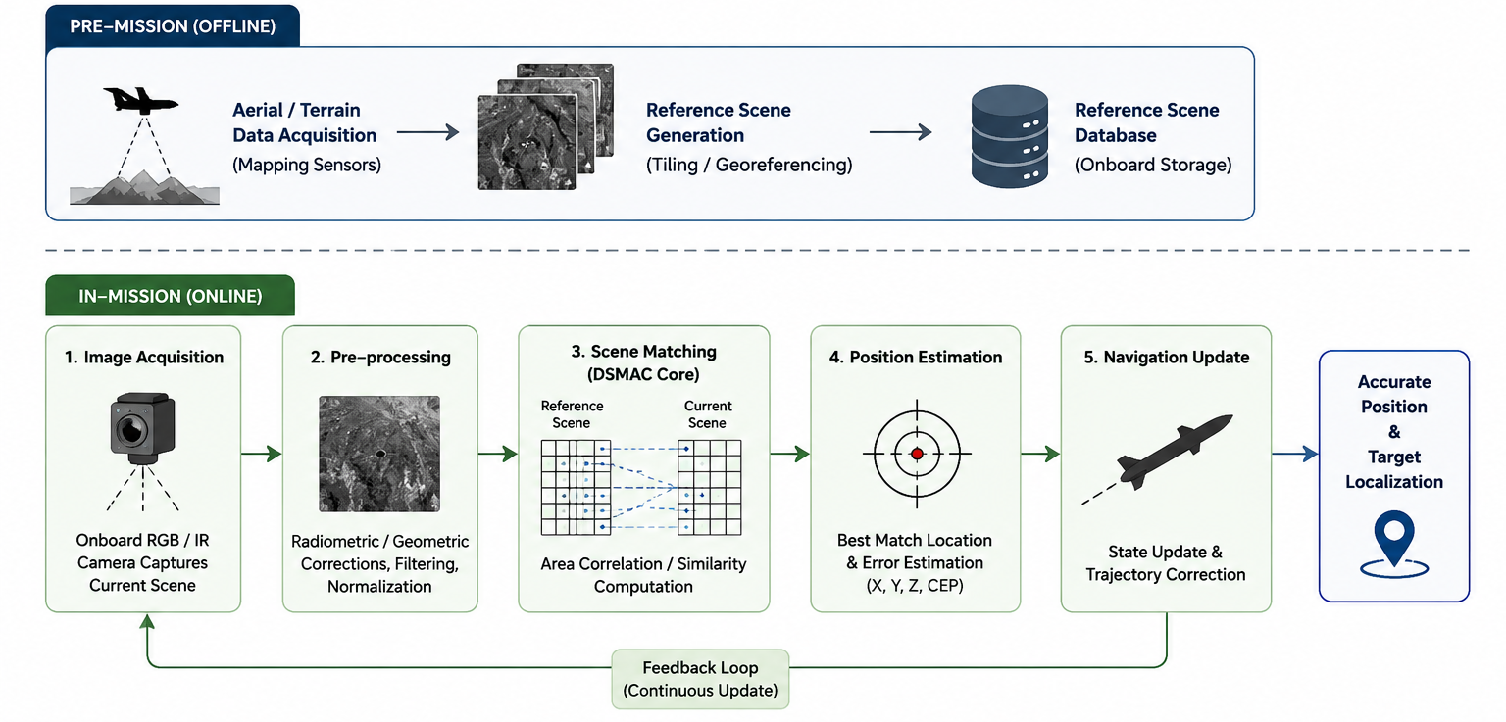
DSMAC – General WORKING PIPELINE

Slide 6
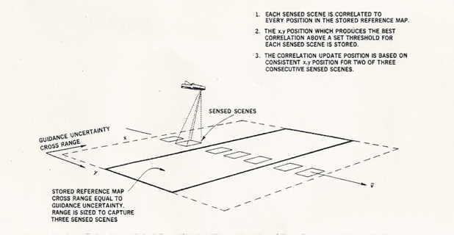
LITERATURE REVIEW
Original DSMAC (1980)
Reference
Carr & Sobek, Digital Scene Matching Area Correlator (DSMAC), Naval Avionics Center,1980
Approach
Area-based image correlation
Correlation Surface Peak Detection
Pixel-wise scene comparison
DSMAC-assisted terminal guidance
Reference image matching
Limitations
Sensitive to illumination and viewpoint changes
High computational complexity
Limited adaptability

Slide 7
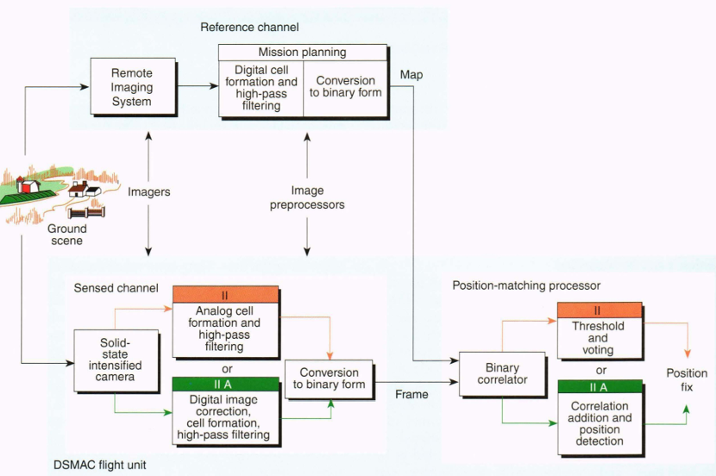
LITERATURE REVIEW
2. Advanced Scene Matching (1994)
Reference
Irani & Christ, Image Processing for Tomahawk Scene Matching, Johns Hopkins APL Technical Digest, 1994
Approach
Enhanced image processing techniques
Improved scene registration
Robust geometric alignment
Optimized image matching for terminal guidance
Contributions
Improved robustness over classical DSMAC
Better handling of scene distortions
Increased localization accuracy
Limitations
Still relied on handcrafted image processing
No learned feature representation
Sensitive to environmental variations

Slide 8
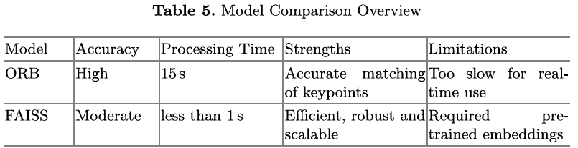
LITERATURE REVIEW
3. AI-Based DSMAC (2026)
Reference
Kashyap et al., ML Based Solution for DSMAC System in Aerial Navigation, 2026.
Approach
ORB feature extraction
ResNet-50 feature learning
FAISS similarity search
CNN-based aerial image matching
Contributions
Deep feature representation
Faster large-scale image retrieval
Improved robustness for aerial navigation
Automated dataset generation
Limitations
High computational requirements
Limited multimodal (RGB–IR) capability

Slide 9
Evolution of DSMAC Image Matching
1980
Pixel Correlation
1994
Advanced Image Processing
2026
Deep Learning-Based Scene Matching
Proposed Work
Cross-Modal (RGB–IR) Transformer-Based Scene Matching

Slide 10
Current State-of-the-Art Feature Matching Methods
Method
Approach
Strength
Limitation
Superpoint
+
Superglue
Sparse keypoints + GNN matching
Accurate and robust matching
High computational cost; RGB-trained
LoFTR
Detector-free transformer-based dense matching
Excellent in low-texture regions
Computationally intensive; RGB-focused
Efficient LoFTR
Lightweight transformer-based dense matching
Faster inference with comparable accuracy
Limited validation on RGB–IR imagery

Slide 11
Current State-of-the-Art Feature Matching Methods (contd.)
Method
Approach
Strength
Limitation
MatchFormer
Coarse-to-fine hierarchical transformer
Robust multi-scale feature matching
High memory usage; not optimized for real-time
ASpanFormer
Adaptive span attention transformer
Handles large viewpoint changes
Complex architecture; higher inference latency
RoMa
Regression-based dense correspondence
Accurate dense pixel-wise matching
Computationally expensive; limited real-time deployment
LightGlue
Adaptive transformer feature matcher
Fast and efficient feature matching
Sparse matching; depends on extracted keypoints

Slide 12
Comparative Analysis of Existing Image Matching Methods
Method
Matching Strategy
Real-Time Performance
RGB–IR Support
Major Limitation
SIFT
Scale-Invariant Feature Matching
Low
No
Computationally expensive; handcrafted descriptors
SURF
Hessian-based Feature Matching
Moderate
No
Handcrafted features, RGB-focused
ORB
Keypoint Matching
High
No
Performance degrades in feature-poor regions
Classical DSMAC (1980)
Area Correlation
Low
No
Sensitive to illumination and viewpoint changes
Advanced DSMAC (1994)
Scene Registration
Moderate
No
Handcrafted processing, limited adaptability

Slide 13
Comparative Analysis of Existing Image Matching Methods (contd.)
Method
Matching Strategy
Real-Time Performance
RGB–IR Support
Major Limitation
SuperPoint
Keypoint Detection
High
No
Trained primarily on RGB datasets
SuperGlue
Graph Neural Network
Moderate
No
High computational complexity
LoFTR
Transformer-based Dense Matching
Moderate
No
Computationally intensive
EfficientLoFTER
Efficient Transformer
High
No
Limited evaluation on cross-modal imagery
LightGlue
Adaptive Transformer
High
No
Sparse correspondence, RGB-focused

Slide 14
Limitations of Existing Approaches
Classical DSMAC
Relies on pixel-level correlation, making it highly sensitive to illumination and viewpoint variations.
Performance degrades significantly under dynamic environmental conditions.
Computationally expensive for large search spaces.
Feature-Based Methods
Depend on handcrafted feature descriptors.
Reduced matching accuracy in texture-poor and repetitive environments.
Limited robustness against large appearance changes.
Deep Learning-Based Methods
Primarily trained and evaluated on RGB image datasets.
Most methods assume same-modality image pairs during feature matching.
Computational complexity limits deployment in high-frequency navigation systems.
Limited evaluation under real-time embedded constraints.

Slide 15
Research Gap
Lack of modality-invariant feature representations for RGB–IR scene matching.
Absence of robust cross-modal correspondence estimation in existing DSMAC systems.
Need for dense feature matching with low computational latency.
Existing methods do not simultaneously satisfy accuracy, robustness, and low-latency performance (50–100 Hz) required for next-generation DSMAC.

Slide 16
Proposed Methodology
Objective
To develop a multimodal DSMAC framework capable of robust scene matching between RGB and infrared imagery by learning a shared latent feature space and performing efficient transformer-based feature correspondence.
Proposed Framework
Step 1: Multimodal Image Acquisition
Simultaneous acquisition of RGB and Infrared (IR) images using synchronized onboard sensors.
Image preprocessing including geometric alignment and normalization.
Step 2: Dual Encoder Network
Independent feature encoders for RGB and IR images.
Learn modality-specific representations while preserving structural scene information.
Project both modalities into a shared latent feature space.

Slide 17
Proposed Methodology (CONTD.)
Step 3: Shared Latent Space Learning
Align RGB and IR feature embeddings using a shared feature representation.
Reduce modality discrepancy while preserving semantic correspondence.
Generate modality-invariant descriptors suitable for feature matching.
Step 4: EfficientLoFTR-based Feature Matching
Apply EfficientLoFTR to perform dense feature correspondence directly in the shared latent space.
Utilize transformer-based attention mechanisms for robust matching.
Eliminate dependency on handcrafted keypoint detectors.
Step 5: DSMAC Localization
Estimate scene correspondences between the onboard image and reference database.
Compute localization error.
Update navigation state and trajectory correction.
Repeat continuously for real-time guidance.

Slide 18
Proposed Methodology (CONTD.)
Robust RGB–IR feature correspondence.
Modality-invariant feature representation.
Dense transformer-based scene matching.
Reduced computational overhead using EfficientLoFTR.
Target real-time performance of 50–100 Hz.
Improved localization accuracy under varying illumination conditions.
Scalable architecture for integration with next-generation autonomous navigation systems.
Expected Advantages
Robust RGB–IR feature correspondence.
Modality-invariant feature representation.
Reduced computational overhead using EfficientLoFTR.
Target low-latency performance of 50–100 Hz.
Improved localization accuracy under varying illumination conditions.
Scalable architecture for integration with next-generation autonomous navigation systems.

Slide 19
Proposed Methodology (CONTD.)
Robust RGB–IR feature correspondence.
Modality-invariant feature representation.
Dense transformer-based scene matching.
Reduced computational overhead using EfficientLoFTR.
Target real-time performance of 50–100 Hz.
Improved localization accuracy under varying illumination conditions.
Scalable architecture for integration with next-generation autonomous navigation systems.
RGB Image
RGB Encoder
Shared Latent Feature Space
EfficientLoFTR Feature Matcher
Dense Feature Correspondence
DSMAC Scene Matching
IR Image
IR Encoder
Position Estimation & Navigation Update

Slide 20
References
Carr & Sobek, Digital Scene Matching Area Correlator (DSMAC), Naval Avionics Center,1980
Irani, M., & Christ, M., Image Processing for Tomahawk Scene Matching, Johns Hopkins APL Technical Digest, vol. 15, no. 3, pp. 249–257, 1994.
Kashyap, P., et al., Machine Learning Based Solution for DSMAC System in Aerial Navigation, 2026.
Rublee, E., Rabaud, V., Konolige, K., & Bradski, G., ORB: An Efficient Alternative to SIFT or SURF, Proceedings of ICCV, 2011.
Lowe, D. G., Distinctive Image Features from Scale-Invariant Keypoints, International Journal of Computer Vision, vol. 60, no. 2, pp. 91–110, 2004.
DeTone, D., Malisiewicz, T., & Rabinovich, A., SuperPoint: Self-Supervised Interest Point Detection and Description, CVPR Workshops, 2018.
Sarlin, P. E., DeTone, D., Malisiewicz, T., & Rabinovich, A., SuperGlue: Learning Feature Matching with Graph Neural Networks, CVPR, 2020.
Sun, J., Shen, Z., Wang, Y., Bao, H., & Zhou, X., LoFTR: Detector-Free Local Feature Matching with Transformers, CVPR, 2021.

Slide 21
References (CONTD.)
Wang, Y., et al., EfficientLoFTR: Semi-Dense Local Feature Matching with Sparse-Like Speed, CVPR, 2024.
Wang, Q., et al., MatchFormer: Interleaving Attention in Transformers for Feature Matching, Asian Conference on Computer Vision (ACCV), 2022.
Chen, Z., et al., ASpanFormer: Detector-Free Image Matching with Adaptive Span Transformer, ECCV, 2022.
Edstedt, J., et al., RoMa: Robust Dense Feature Matching, CVPR, 2024.
Lindenberger, P., Sarlin, P. E., & Pollefeys, M., LightGlue: Local Feature Matching at Light Speed, ICCV, 2023.
Johnson, J., Douze, M., & Jégou, H., Billion-Scale Similarity Search with GPUs, IEEE Transactions on Big Data, 2021.
He, K., Zhang, X., Ren, S., & Sun, J., Deep Residual Learning for Image Recognition, CVPR, 2016.
Vaswani, A., et al., Attention Is All You Need, NeurIPS, 2017.

